Slide 1
Fundamental concepts of DBMS
1.1

Slide 2
Why Data Management is Important
One of the most valuable resources of any business is the data stored by the business. The efficient management of data is a key business activity. A systematic approach to data management allows data to become information.

Slide 3
When Data Becomes Information
When data is organized in a meaningful way, information that may not have been easily observable becomes apparent. For example, total sales, buying trends for February 2020 etc. Effective data management enables raw data to become useful information.

Slide 4
Database Management System
Definition:
  A database (DB) is an integrated collection of related data
  A Database Management System (DBMS) is a collection of programs that control the database
Primary goal of DBMS: is to store and manage data
  Conveniently
  Efficiently

Slide 5
Related Data
Data is raw facts on some aspect of the world
  bytes + structure = data
Related data:
  Represent logically coherent facts of the real world (miniworld or Universe of Discourse)
  E.g., information about a University
  data + semantics = information
Any random collection of data is not a database

Slide 6
Integrated Data
All data are stored and manipulated in a uniform way on a secondary storage
  Databases store large amounts of data that cannot fit in main memory.
  Data are stored for long and indefinite period
  Data are shared across multiple applications

Slide 7
Database Management Systems and Database Systems
A DBMS is a general purpose software system that enables users to create, maintain, and manipulate a DB
  E.g., Oracle, IBM DB2, SQL-Server, Postgres, MySQL, MS Access, Interbase, Sybase, …
Fast and convenient access to information
Definition: A Database system (DBS) consists of DB + DBMS + Application Programs

Slide 8
Example Usages of Database Management systems
Airlines – reservations and schedules (expedia.com)
Banking – customer info and accounts (WellsFargo.com)
Universities – student info, grades
Government – taxes, budgets, legislation, census
Sales – inventory, customer info (Amazon.com, eBay)
Credit Cards – transactions, customer info
Newspapers – track subscribers, advertising revenue
Financial – stock prices, portfolio info
Telecommunications – record of calls made
Many more!

Slide 9
History
Integrated Data Store, first general-purpose DBMS, early 1960s, Charles Bachman, General Electrics
Information Management System (IMS), late 1960s, IBM
Relational database model, proposed in 1970, Edgar Codd, IBM’s San Jose Laboratory
Structured Query Language (SQL), standardized in the late 1980s
More powerful query languages, complex analysis of data, support for new data types (e.g., images), late 1980s and 1990s
Packages which come with powerful customizable application layers
Internet

Slide 10
Queries and Transactions
Queries: requests to the DBMS to retrieve data from the database
Updates: requests to the DMBS to insert, delete or modify existing data
Transactions: logical grouping of query and update requests to perform a task
  deposit, withdraw, transfer money
  credit charge at e-Store
Read-only or query transactions: transactions that only query the database, no updates

Slide 11
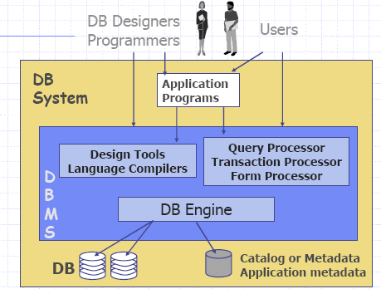
Simplified Database System Organization

Slide 12
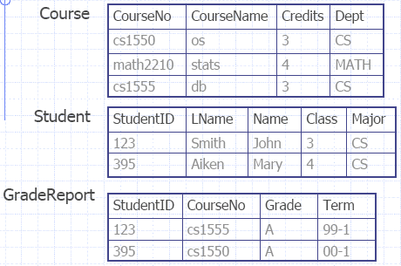
Example of Relational Database:
Student Records

Slide 13
Approaches to management of data
Database approach
File system approach
  Traditional (flat) files + C (Java, ...) programs to access them
  E.g., use one (or more) UNIX/DOS files, with student records and their courses
  Decide on a layout for the student records, etc…

Slide 14

File layout for the student records…
Many layouts are fine, e.g.:
comma-separated values ‘csv’
  Smith,John,123,cs1555,db,A,99-1
  Tompson,Peter,234
  Aiken,Mary,395,cs1550,os,A,00-1,math2210,stats,A,99-2
Data split into two files

Slide 15
Database Vs. File Systems Approaches
Data Abstraction
Reliability
Efficiency/Performance

Slide 16
Data Abstraction
Data models: High-level conceptual representation of data
A data model is a description of the data, relationships between the data and the constraints on the data.
  External, Conceptual and Internal Data Models.
  Set of primitives for defining the schema of a DB (DDL: data definition language)
  Set of primitives for specifying retrievals and updates (DML: data manipulation language)
  A data model is like a programming language – whose construct can be used to solve a wide variety of specific problems, but in and of themselves have no direct connection with any such specific problem.

Slide 17
Data Models
Hierarchical Model
Network Model
Entity-Relationship Model
Relational Model
Object-Oriented Data Model
Object-Relational Data Model
Flat Data Model
Semi-Structured Data Model
Associative Data Model
Context Data Model

Slide 18
Hierarchical Model
Hierarchical Model was the first DBMS model. This model organises the data in the hierarchical tree structure.
The hierarchy starts from the root which has root data and then it expands in the form of a tree adding child node to the parent node.

Slide 19
Hierarchical Model (Contd…)
This model easily represents some of the real-world relationships like food recipes, sitemap of a website etc.
Example: We can represent the relationship between the shoes present on a shopping website in the following way:

Slide 20
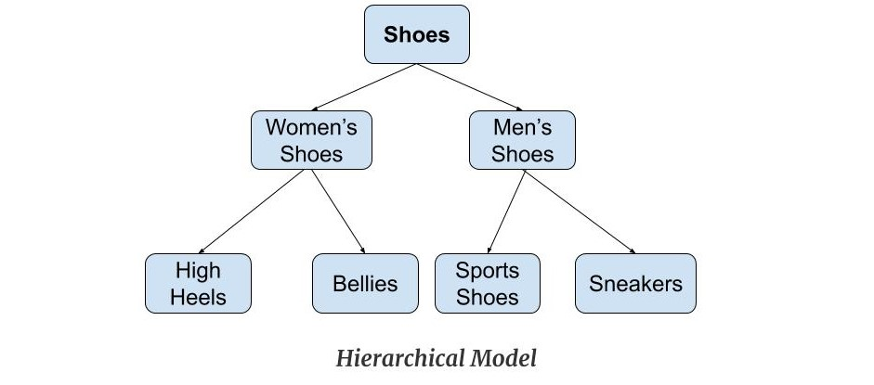
Hierarchical Model (Contd…)

Slide 21
Hierarchical Model (Contd…)
Features of a Hierarchical Model
One-to-many relationship: The data here is organised in a tree-like structure where the one-to-many relationship is between the datatypes. Also, there can be only one path from parent to any node. Example: In the above example, if we want to go to the node sneakers we only have one path to reach there i.e through men's shoes node.
Parent-Child Relationship: Each child node has a parent node but a parent node can have more than one child node. Multiple parents are not allowed.

Slide 22
Hierarchical Model (Contd…)
Deletion Problem: If a parent node is deleted then the child node is automatically deleted.
Pointers: Pointers are used to link the parent node with the child node and are used to navigate between the stored data.
Example: In the above example the 'shoes' node points to the two other nodes 'women shoes' node and 'men's shoes' node.

Slide 23
Hierarchical Model (Contd…)
Advantages of Hierarchical Model
It is very simple and fast to traverse through a tree-like structure.
Any change in the parent node is automatically reflected in the child node so, the integrity of data is maintained.

Slide 24
Hierarchical Model (Contd…)
Disadvantages of Hierarchical Model
Complex relationships are not supported.
As it does not support more than one parent of the child node so if we have some complex relationship where a child node needs to have two parent node then that can't be represented using this model.
If a parent node is deleted then the child node is automatically deleted.

Slide 25
Network Model
This model is an extension of the hierarchical model.
It was the most popular model before the relational model.
This model is the same as the hierarchical model, the only difference is that a record can have more than one parent.
It replaces the hierarchical tree with a graph.
Example: In the example below we can see that node student has two parents i.e. CSE Department and Library. This was earlier not possible in the hierarchical model.

Slide 26
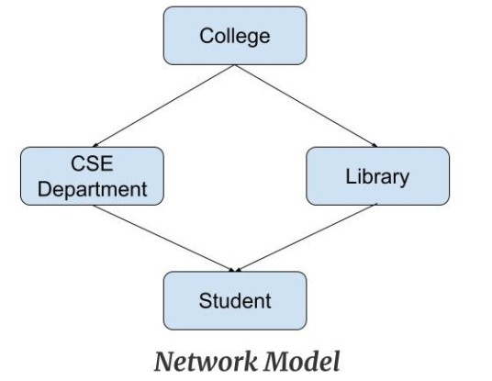
Network Model (Contd…)

Slide 27
Network Model (Contd…)
Features of a Network Model
Ability to Merge more Relationships: In this model, as there are more relationships so data is more related. This model has the ability to manage one-to-one relationships as well as many-to-many relationships.
Many paths: As there are more relationships so there can be more than one path to the same record. This makes data access fast and simple.

Slide 28
Network Model (Contd…)
Circular Linked List: The operations on the network model are done with the help of the circular linked list. The current position is maintained with the help of a program and this position navigates through the records according to the relationship.

Slide 29
Network Model (Contd…)
Advantages of Network Model
The data can be accessed faster as compared to the hierarchical model. This is because the data is more related in the network model and there can be more than one path to reach a particular node. So the data can be accessed in many ways.
As there is a parent-child relationship so data integrity is present. Any change in parent record is reflected in the child record.

Slide 30
Network Model (Contd…)
Disadvantages of Network Model
As more and more relationships need to be handled the system might get complex. So, a user must be having detailed knowledge of the model to work with the model.
Any change like updation, deletion, insertion is very complex.

Slide 31
Entity-Relationship Model
Entity-Relationship Model or simply ER Model is a high-level data model diagram.
In this model, we represent the real-world problem in the pictorial form to make it easy for the stakeholders to understand.
It is also very easy for the developers to understand the system by just looking at the ER diagram.
We use the ER diagram as a visual tool to represent an ER Model.

Slide 32
Entity-Relationship Model (Contd…)
ER diagram has the following three components:
Entities: Entity is a real-world thing. It can be a person, place, or even a concept. Example: Teachers, Students, Course, Building, Department, etc are some of the entities of a School Management System.
Attributes: An entity contains a real-world property called attribute. This is the characteristics of that attribute. Example: The entity teacher has the property like teacher id, salary, age, etc.
Relationship: Relationship tells how two attributes are related. Example: Teacher works for a department.

Slide 33
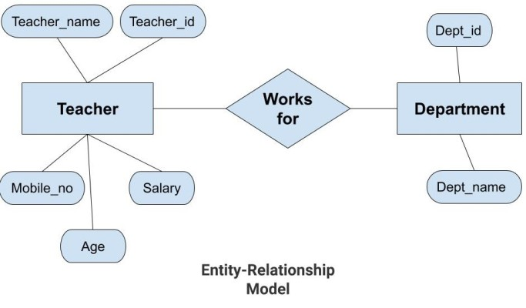
Entity-Relationship Model (Contd…)

Slide 34
Entity-Relationship Model (Contd…)
Features of ER Model
Graphical Representation for Better Understanding: It is very easy and simple to understand so it can be used by the developers to communicate with the stakeholders.
ER Diagram: ER diagram is used as a visual tool for representing the model.
Database Design: This model helps the database designers to build the database and is widely used in database design.

Slide 35
Entity-Relationship Model (Contd…)
Advantages of ER Model
Simple: Conceptually ER Model is very easy to build. If we know the relationship between the attributes and the entities we can easily build the ER Diagram for the model.
Effective Communication Tool: This model is used widely by the database designers for communicating their ideas.
Easy Conversion to any Model: This model maps well to the relational model and can be easily converted relational model by converting the ER model to the table. This model can also be converted to any other model like network model, hierarchical model etc.

Slide 36
Entity-Relationship Model (Contd…)
Disadvatages of ER Model
No industry standard for notation: There is no industry standard for developing an ER model. So one developer might use notations which are not understood by other developers.
Hidden information: Some information might be lost or hidden in the ER model. As it is a high-level view so there are chances that some details of information might be hidden.

Slide 37
Relational Model
Relational Model is the most widely used model. In this model, the data is maintained in the form of a two-dimensional table.
All the information is stored in the form of row and columns. The basic structure of a relational model is tables.
So, the tables are also called relations in the relational model.
Example: In this example, we have an Employee table.

Slide 38
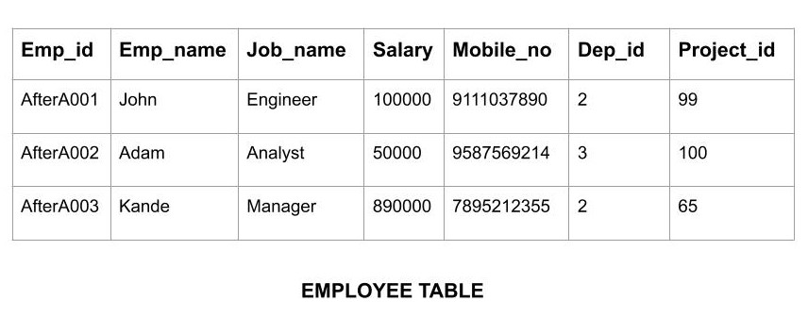
Relational Model (Contd…)

Slide 39
Relational Model (Contd…)
Features of Relational Model
Tuples: Each row in the table is called tuple. A row contains all the information about any instance of the object. In the above example, each row has all the information about any specific individual like the first row has information about John.
Attribute or field: Attributes are the property which defines the table or relation. The values of the attribute should be from the same domain. In the above example, we have different attributes of the employee like Salary, Mobile_no, etc.
Advantages of Relational Model
Simple: This model is more simple as compared to the network and hierarchical model.
Scalable: This model can be easily scaled as we can add as many rows and columns we want.
Structural Independence: We can make changes in database structure without changing the way to access the data. When we can make changes to the database structure without affecting the capability to DBMS to access the data we can say that structural independence has been achieved.
Disadvantages of Relational Model
Hardware Overheads: For hiding the complexities and making things easier for the user this model requires more powerful hardware computers and data storage devices.
Bad Design: As the relational model is very easy to design and use. So the users don't need to know how the data is stored in order to access it. This ease of design can lead to the development of a poor database which would slow down if the database grows.

Slide 40
Object-Oriented Data Model
The real-world problems are more closely represented through the object-oriented data model. In this model, both the data and relationship are present in a single structure known as an object. We can store audio, video, images, etc in the database which was not possible in the relational model(although you can store audio and video in relational database, it is advised not to store in the relational database). In this model, two are more objects are connected through links. We use this link to relate one object to other objects. This can be understood by the example given below.

Slide 41
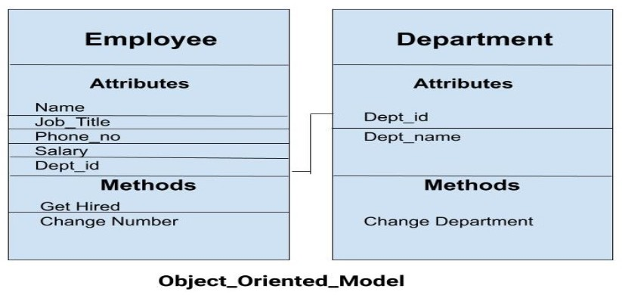
Object-Oriented Data Model (Contd…)

Slide 42
Object-Relational Model
As the name suggests it is a combination of both the relational model and the object-oriented model. This model was built to fill the gap between object-oriented model and the relational model. We can have many advanced features like we can make complex data types according to our requirements using the existing data types. The problem with this model is that this can get complex and difficult to handle. So, proper understanding of this model is required.

Slide 43
Flat Data Model
It is a simple model in which the database is represented as a table consisting of rows and columns. To access any data, the computer has to read the entire table. This makes the modes slow and inefficient.

Slide 44
Semi-Structured Model
Semi-structured model is an evolved form of the relational model. We cannot differentiate between data and schema in this model. Example: Web-Based data sources which we can't differentiate between the schema and data of the website. In this model, some entities may have missing attributes while others may have an extra attribute. This model gives flexibility in storing the data. It also gives flexibility to the attributes. Example: If we are storing any value in any attribute then that value can be either atomic value or a collection of values.

Slide 45
Context Data Model
Context Data Model is a collection of several models. This consists of models like network model, relational models etc. Using this model we can do various types of tasks which are not possible using any model alone.

Slide 46
Associative Data Model
Associative Data Model is a model in which the data is divided into two parts. Everything which has independent existence is called as an entity and the relationship among these entities are called association. The data divided into two parts are called items and links.
Item: Items contain the name and the identifier(some numeric value).
Links: Links contain the identifier, source, verb and subject.
Example: Let us say we have a statement "The world cup is being hosted by London from 30 May 2020". In this data two links need to be stored:
The world cup is being hosted by London. The source here is 'the world cup', the verb 'is being' and the target is 'London'.
...from 30 May 2020. The source here is the previous link, the verb is 'from' and the target is '30 May 2020'.
This is represented using the table as follows:

Slide 47
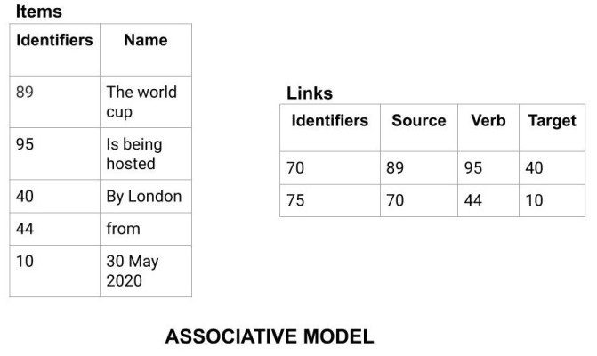
Associative Data Model
(Contd…)

Slide 48
Data Abstraction Contd…
Data are structured in a way meaningful to applications
Physical organization is hidden, stored in the catalog
Program-data independence
  Consider adding a new field
Program-operation independence
  User-defined abstract operation
Data sharing and integration

Slide 49
Database Schema & Instances
Database schema: is the structure of the DB that
  captures data types, relationships, constraints on the data
  is independent of any application program
  changes infrequently
  Similar to types and variables in programming languages
Database instances or state: the actual data in the DB at a particular moment in time
  Analogous to the value of a variable.

Slide 50
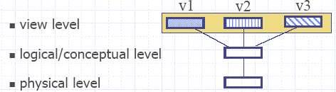
Data Abstraction…Views
Multiple Views of data allows each user/application to get different perspective of the database
The three-level architecture (ANSI/SPARC Architecture)

Slide 51
3-level Architecture (ANSI/APARC Architecture)
View level (External Level):
  Different users may view the data in different ways.
  This may involve viewing data in different formats, or derived values which are not stored persistently in the database.
  Only the data relevant to the particular user need be included in the user’s view.
    E.G. CSMajors, MathMajors

Slide 52
3-level Architecture (ANSI/APARC Architecture)
Logical level (Conceptual Level): entire database schema
  The logical structure of the entire database described by the conceptual schema.
  All data entities, attributes and relationships included.
  Integrity constraints.
  All external views must be derivable from conceptual schema.
  Independent of any storage details.
  E.G.
  Courses (CourseNo,CourseName,Credits,Dept)
  Student (StudentID,Lname,Name,Class,Major)
  GradeReport (StudentID,CourseNo,Grade,Term)

Slide 53
3-level Architecture (ANSI/APARC Architecture)
Physical level (Internal Level):
  Internal schema describes the physical storage characteristics of the data.
  Storage space allocations.
  Indexes.
  Compression/Encryption etc.
  Independent of any particular application software.
  Physical
  How these tables are stored, how many bytes / attribute etc.

Slide 54
Data independence
When a schema at a lower level is changed, only the mappings between this schema and higher-level schemas need to be changed in a DBMS that fully supports data independence. The higher-level schemas themselves are unchanged. Hence, the application programs need not be changed since they refer to the external schemas.

Slide 55
Data independence Cont…
Logical Data Independence – the ability to modify the logical schema without changing the external schema (view).
  can add (drop) column; add/drop table
Physical Data Independence – the ability to modify the physical schema without changing the logical schema.
  Applications depend on the logical schema
  In general, the interfaces between the various levels and components should be well defined so that changes in some parts do not seriously influence others
  can add index; change record order

Slide 56
Reliability
Enforcing integrity constraints
  E.g., data type, relationship between values
  Data in DB must satisfy the integrity constraints
  Integrity constraints are stored in the catalog
Ensuring data integrity despite failures
  Data are not lost when the system fails for whatever reason
  Failed transactions are rolled back

Slide 57
Ensuring data integrity…
Security
  Encryption
  Authentication
Access control
  Who(user/role), what(data), how(operations)
  Views and access permissions in the catalog

Slide 58
Efficiency and Performance
Space efficiency:
  minimizes data redundancy by storing data only once
Time efficiency (response time):
  eliminates the need for multiple updates to keep the replicas consistent and up-to-date
  Enhances query performance by means of optimizations and access methods
  Allows many users (transactions) to access the DB concurrently:
    Read the same data, update different data
    Sequential access delays grow exponentially with # of transactions
    Concurrency Control: not to step on each other’s toes

Slide 59
Drawbacks of using file systems to store data
Data redundancy and inconsistency
Multiple file formats, duplication of information in different files
Difficulty in accessing data
Need to write a new program to carry out each new task
Data isolation — multiple files and formats
Integrity problems
  Integrity constraints (e.g. account balance > 0) become part of program Code
Hard to add new constraints or change existing ones
Atomicity of updates
Failures may leave database in an inconsistent state with partial updates carried out.
  E.g. transfer of funds from one account to another should either complete or not happen at all
Concurrent access by multiple users
Concurrent access needed for performance
Uncontrolled concurrent accesses can lead to inconsistencies
  E.g. two people reading a balance and updating it at the same time
Security problems
Database systems offer solutions to all the above problems

Slide 60
Advantages of Database Processing
Extracting Information from Data
Sharing of Data
Standards
Controlled Redundancy
Integrity Control
Security
Economy of Scale
Data Independence

Slide 61
Advantages of Database Processing Cont…
Extracting Information from Data
Storing data in a central shared database enables users to efficiently extract information. This information may include analyses of patterns, trends and derived characteristics of the data. Database query languages and report generators provided by most DBMS packages enable a common and controlled approach to information extraction.
Sharing of Data
Data sharing refers to the capacity to make data simultaneously accessible by many users without mutual interference. Sharing of data reduces redundancy ( no need to store multiple copies of data for different users).
Security of access is easier to control and data integrity is easier to ensure. DBMS package needs to provide some measure of concurrency control to ensure no mutual interference.

Slide 62
Advantages of Database Processing Cont…
Standards
Centralization of data storage requires that design standards and methodologies be developed and adhered to across the business enterprise. It is one of the roles of the DBA (Database Administrator) to ensure that standards be observed. Eg. Data naming standards, enforcement of data integrity rules, coding standards – error handling, data access standards
Controlled Redundancy
Pre-database applications employed dedicated files. That is, the Payroll application, say, “owned” its own files, as did say, the Projects application. Often, the same data, e.g. an Employee file, was held by more than one application. Redundant data was often not easily identifiable since the only place the files were described was in the programs accessing them.

Slide 63
Advantages of Database Processing Cont…
Problems associated with redundant data:
Wastage of storage space, wastage of processing time on multiple updates possibility of data inconsistency
Integrity Control
Data integrity ensures that data does not become inconsistent.
Integrity constraints (rules) can be defined to the DBMS in order to protect the integrity of data. Most DBMS software will allow various degrees of specification and enforcement of integrity constraints.

Slide 64
Advantages of Database Processing Cont…
Security
Security is important because of data integration - some of the data in the central database may be of a sensitive and/or critical nature. Access to data may be restricted only to authorized users. Different levels of access may be defined depending on the role of the user in the organisation. Database administrator can define and police security policies and backup / recovery routines.
Economy of Scale
Data is combined into a single database. Multiple applications can be standardized to interact with this one data source. Therefore, cost savings may be realized because there is no need for individual departmental data management budgets.
Data Independence
Description of the data is stored in one central place (the schema). Therefore, applications do not have to be recompiled when the format of the data changes. Hence lower maintenance overheads. e.g. Logical data independence & Physical data independence.

Slide 65
Applicability
When a DBMS is needed?
To integrate efficiently and correctly large volumes of related data
Supports sharing and discovering of information
  Data mining, deductive databases, active databases
DBMS ensure true QoS (Quality of Services)
When a DBMS is Inappropriate?
Disadvantages:
  Expensive to buy
  Expensive to maintain (need administrator)
  “Expensive” to run (needs significant resources)
Hence, it is “over-kill” when
  The database is small
  The database has simple structure
  The application is simple and not expected to change
  Can tolerate failures
  Do not require multiple, concurrent users

Slide 66
DBMS Languages
Data Definition Language (DDL): Used by the DBA and database designers to specify the conceptual schema of a database. In many DBMSs, the DDL is also used to define internal and external schemas (views). In some DBMSs, separate storage definition language (SDL) and view definition language (VDL) are used to define internal and external schemas.
Data Manipulation Language (DML): Used to specify database retrievals and updates.
  DML commands (data sublanguage) can be embedded in a general-purpose programming language (host language), such as COBOL, C or an Assembly Language.
  Alternatively, stand-alone DML commands can be applied directly (query language).
High Level or Non-procedural Languages: e.g., SQL, are set-oriented and specify what data to retrieve than how to retrieve. Also called declarative languages.
Low Level or Procedural Languages: record-at-a-time; they specify how to retrieve data and include constructs such as looping.

Slide 67
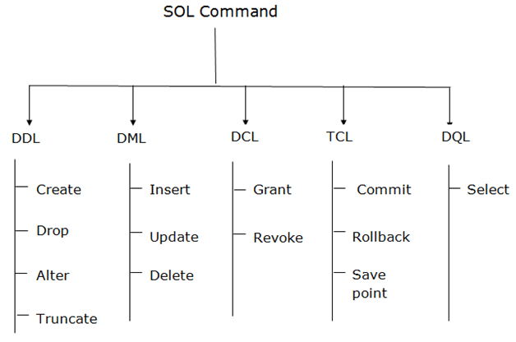

Slide 68
DDL (Data Definition Language):
DDL or Data Definition Language actually consists of the SQL commands that can be used to define the database schema. It simply deals with descriptions of the database schema and is used to create and modify the structure of database objects in the database.DDL is a set of SQL commands used to create, modify, and delete database structures but not data. These commands are normally not used by a general user, who should be accessing the database via an application.

Slide 69
List of DDL commands
CREATE: This command is used to create the database or its objects (like table, index, function, views, store procedure, and triggers).
DROP: This command is used to delete objects from the database.
ALTER: This is used to alter the structure of the database.
TRUNCATE: This is used to remove all records from a table, including all spaces allocated for the records are removed.
COMMENT: This is used to add comments to the data dictionary.
RENAME: This is used to rename an object existing in the database.

Slide 70
DQL (Data Query Language)
DQL statements are used for performing queries on the data within schema objects. The purpose of the DQL Command is to get some schema relation based on the query passed to it. We can define DQL as follows it is a component of SQL statement that allows getting data from the database and imposing order upon it. It includes the SELECT statement. This command allows getting the data out of the database to perform operations with it. When a SELECT is fired against a table or tables the result is compiled into a further temporary table, which is displayed or perhaps received by the program i.e. a front-end.

Slide 71
List of DQL
.
SELECT: It is used to retrieve data from the database

Slide 72
DML(Data Manipulation Language)
The SQL commands that deals with the manipulation of data present in the database belong to DML or Data Manipulation Language and this includes most of the SQL statements. It is the component of the SQL statement that controls access to data and to the database. Basically, DCL statements are grouped with DML statements.
List of DML commands:
INSERT : It is used to insert data into a table.
UPDATE: It is used to update existing data within a table.
DELETE : It is used to delete records from a database table.
LOCK: Table control concurrency.
CALL: Call a PL/SQL or JAVA subprogram.
EXPLAIN PLAN: It describes the access path to data.

Slide 73
DCL (Data Control Language)
DCL includes commands such as GRANT and REVOKE which mainly deal with the rights, permissions, and other controls of the database system.
List of DCL commands:
GRANT: This command gives users access privileges to the database.
REVOKE: This command withdraws the user’s access privileges given by using the GRANT command.

Slide 74
Transaction Control Language
Though many resources claim there to be another category of SQL clauses TCL – Transaction Control Language. So we will see in detail about TCL as well. TCL commands deal with the transaction within the database.
List of TCL commands:
COMMIT: Commits a Transaction.
ROLLBACK: Rollbacks a transaction in case of any error occurs.
SAVEPOINT:Sets a savepoint within a transaction.
SET TRANSACTION: Specify characteristics for the transaction.

Slide 75
Database System
Database system involves four major components;
Hardware
Software
Data
Procedures
Database Access Language

Slide 76
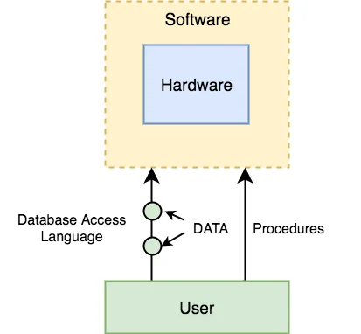
Components of DBMS

Slide 77
Hardware
The secondary storage volume – mostly magnetic disks that are used to hold the stored data, together with the associated i/o devices (disks drives etc.), device controller, i/o channels, and so forth and
The hardware processors and associated main memory that are used to support the execution of the database system s/w.

Slide 78
Software
This is the main component, as this is the program which controls everything. The DBMS software is more like a wrapper around the physical database, which provides us with an easy-to-use interface to store, access and update data.
The DBMS software is capable of understanding the Database Access Language and interpret it into actual database commands to execute them on the DB.

Slide 79
Data
Database systems are available on machines that range all the way from the smallest personal computers to the largest mainframes. Needless to say, the facilities provided by any given system are determined to some extent by the size and power of the underlying machine. In particular, systems on large machines (“large systems”) tend to multi-user, whereas those on smaller machines (“smaller system”) tend to be single-user.
A Single-user system is a system in which at most one user can access the database at any given time; a multi-user system is a system in which many users can access the database at the same time.
A major objective of multi-user system in general is precisely to allow each user to behave as if he or she working with a single user system instead. The special problems of multi-user system are primarily problems that are internal to the system not ones that are visible to the user.
In general then the data in the database at least in larger system will be both integrated and shared.

Slide 80
Procedures
Procedures refer to general instructions to use a database management system. This includes procedures to setup and install a DBMS, To login and logout of DBMS software, to manage databases, to take backups, generating reports etc.

Slide 81
Database Access Language
Database Access Language is a simple language designed to write commands to access, insert, update and delete data stored in any database.
A user can write commands in the Database Access Language and submit it to the DBMS for execution, which is then translated and executed by the DBMS.
User can create new databases, tables, insert data, fetch stored data, update data and delete the data using the access language.

Slide 82
Users
Application programmers : responsible for writing database application programs in some programming languages such as COBOL, PL/I, C++, Java or some higher-level “Forth generation” languages.
End Users: who interacts with the system from online workstation or terminals.
Database Administrator (DBA)

Slide 83
Database System Structure
The functional components of a database system can be broadly divided into:
The storage manager
The query processor components.

Slide 84

Database System Structure

Slide 85
Storage Manager
Storage manager is a program module that provides the interface between the low-level data stored in the database and the application programs and queries submitted to the system. The storage manager is responsible to the following tasks:
  interaction with the file manager
  efficient storing, retrieving and updating of data

Slide 86
The storage manager components include:
Authorization and integrity manager: which tests for the satisfaction of integrity constraints and checks the authority of users to access data
Transaction Manager: which ensures that the database remains in a consistent (correct) state despite system failures, and that concurrent transaction execution proceed without conflicting.
File Manager: which manages the allocation of space on disk storage and the data structures used to represent information stored on disk.
Buffer Manager: which is responsible for fetching data from disk storage into main memory, and deciding what data to cache in main memory. The manager is a critical part of the database system, since it enables the database to handle data sizes that are much larger than the size of main memory.

Slide 87
The storage manager
The storage manager implements several data structures as part of the physical system implementation:
Data files, which store the database itself.
Data Dictionary, which stores metadata about the structure of the database in particular the schema of the database.
Indices, which provides fast access to data items that hold particular values.

Slide 88
The Query Processor
The query processor components include:
DDL interpreter, which interprets DDL statements and records the definitions in the data dictionary.
DML Compiler, which translates DML statements in a query language into an evaluation plan consisting of low-level instructions that the query evaluation engine understand.
A query can usually be translated into any of a number of alternative evaluation plans that all give the same result. The DML compiler also performs Query Optimization, that is, it picks the lowest cost evaluation plan from among the alternatives.
Query evaluation engine, which executes low-level instructions generated by DML compiler.

Slide 89
The Data Communications Manager
The DC manager is not part of the DBMS but is an autonomous system in its own right. However, since it is clearly required to work in harmony with the DBMS, the two are some times regarded as equal partners in a higher-level cooperative ventures called the Data base/data-communications system (DB/DC system), in which DBMS looks after the database and the DC manager handles all messages to and from the DBMS, or more accurately to and from applications that use the DBMS.

Slide 90
DBMS Interfaces
Stand-alone query language interfaces.
Programmer interfaces for embedding DML in programming languages:
  Pre-compiler Approach
  Procedure (Subroutine) Call Approach
User-friendly interfaces:
  Menu-based, popular for browsing on the web
  Forms-based, designed for naïve users
  Graphics-based (Point and Click, Drag and Drop etc.)
  Natural language: requests in written English
  Combinations of the above

Slide 91
Classification of DBMSs
Based on the data model used:
  Traditional: Relational, Network, Hierarchical.
  Emerging: Object-oriented, Object-relational.
Other classifications:
  Single-user (typically used with microcomputers) vs. multi-user (most DBMSs).
  Centralized (uses a single computer with one database) vs. distributed (uses multiple computers, multiple databases)

